Slide 1
Visualising Spatial Data

Slide 2
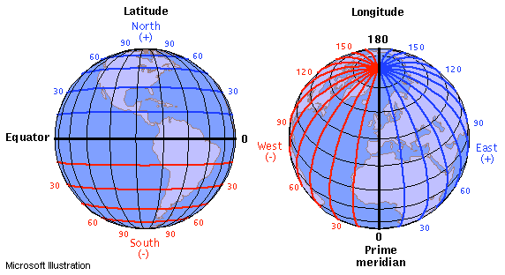
Coordinate System
https://journeynorth.org/tm/LongitudeIntro.html
Notes:
Lats, longs, make sure how to read them

Slide 3
Introduction to Spatial Data
Health Outcomes and risks are often tied to where people live, work, interact with their environment.
Spatial data- allows us to see patterns and relationships on a map, offering insights missed by traditional plots
Where are disease outbreaks occurring?
Disease surveillance over time
Interaction between environment and health
Visualising resource allocation and inequalities
Notes:
Check extra workshops

Slide 4
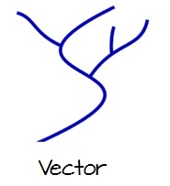
Introduction to Spatial Data- Basic Terms
Vector data
Spatial data presented using points, lines and polygons.
Usually discrete data, and can point information to exact locations.
Used for features that have a clear
defined location/shape.
Notes:
Check extra workshops

Slide 5
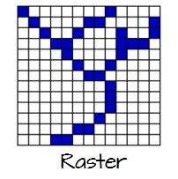
Introduction to Spatial Data- Basic Terms
Raster data
Data presented in a grid of pixels. Each pixel has a value- usually colour, or some unit of measurement
Think of a raster as a layer
Usually satellite images
Representing phenomenon that
gradually changes across
space
Notes:
Check extra workshops

Slide 6
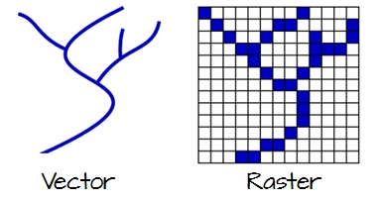
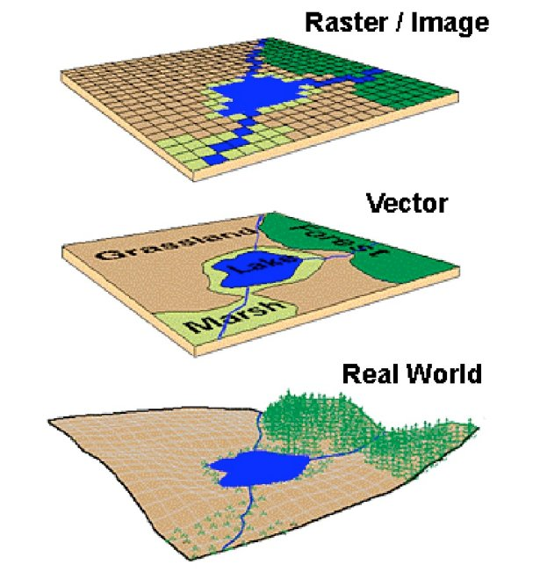
Vectors vs Rasters
Saab, D. J. (2004). Conceptualizing space: mapping schemas as meaningful representations–Indigenous narratives of place.
Notes:
Check extra workshops

Slide 7
Vectors vs Rasters Examples
Vector Data
Points- Locations of hospitals, reported cases of disease
Lines- Routes for ambulances
Polygons- Boundaries of health districts
Raster Data
Continuous Data- Temperature Variations, air quality
Land Use- Urbanisation and Vegetation Cover
Pollution and Exposure- Soil Contamination or water pollution
Genomics and population studies
Saab, D. J. (2004). Conceptualizing space: mapping schemas as meaningful representations–Indigenous narratives of place.
Notes:
Check extra workshops

Slide 8
Introduction to Spatial Data- Basic Terms
Shapefile- Geospatial vector data format for Geographical Information Systems (GIS)
Admin Level- Administrative level of a feature
Level 0: Countries
Level 1: States, Provinces, Regions
Level 2: Counties, Districts (Urban/Suburban)
Level 3: Cities, Communes
Level 4: Villages, Wards
* You might need to download the correct admin level shapefile!
Notes:
Check extra workshops

Slide 9
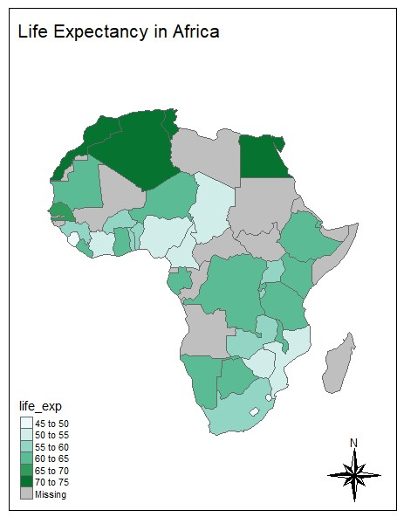
Different visualisations using Maps
Choropleth Maps- Using different shades to represent data.
Examples: Disease Prevalence in region, income levels
Notes:
Check extra workshops

Slide 10
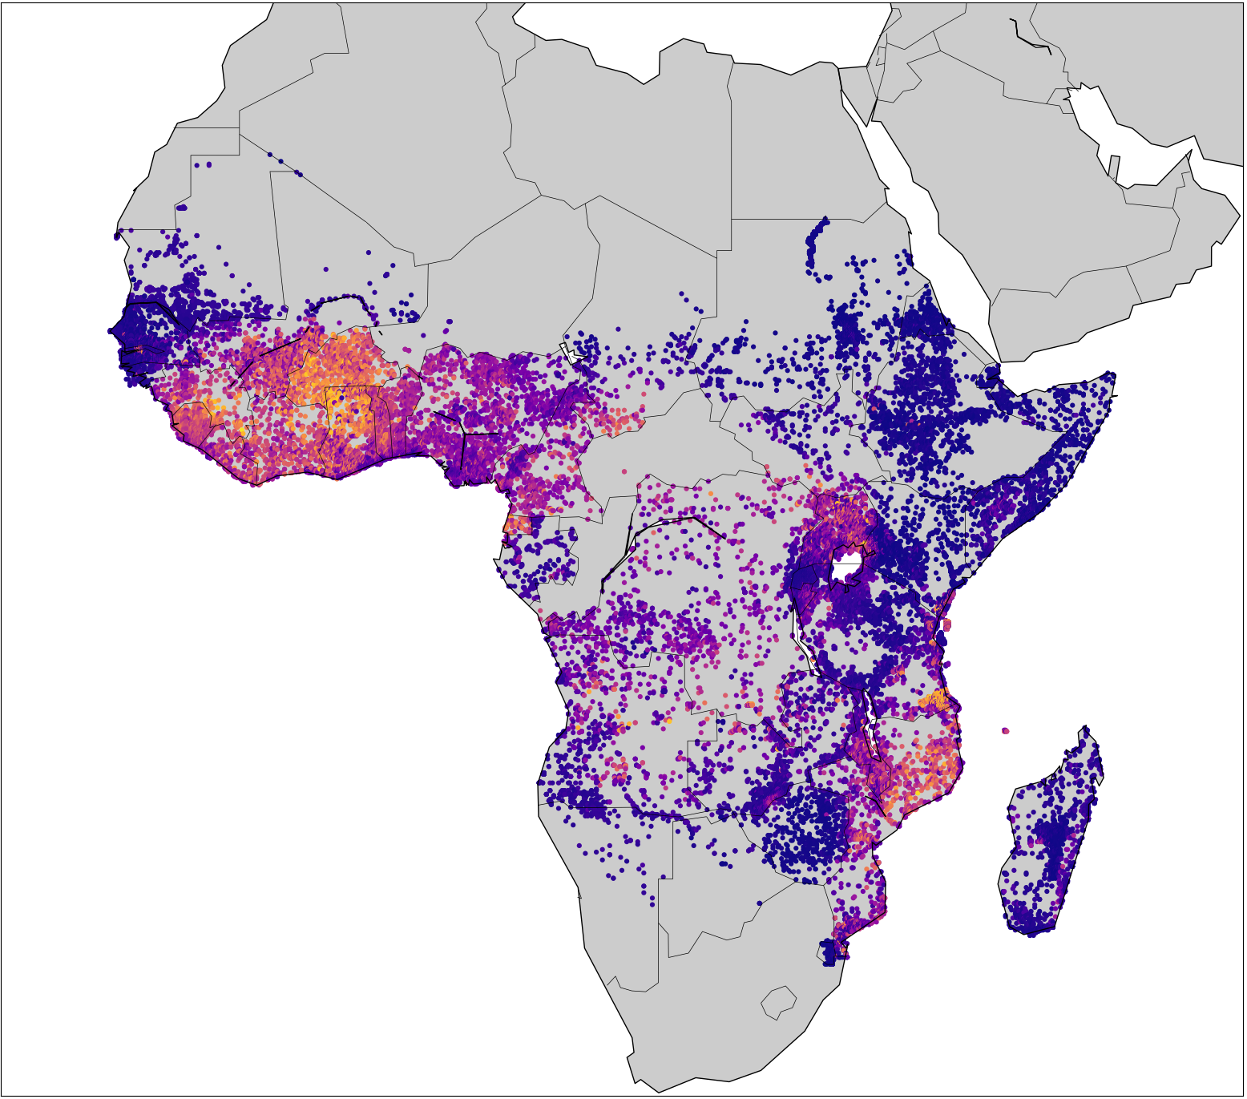
Different visualisations using Maps
Point Maps- Simple point maps. Value of variable at location. Precise information
Examples: Disease Prevalence at location, Vaccination centre locations
Malaria Prevalence Africa at DHS locations (2010)
Notes:
Check extra workshops

Slide 11
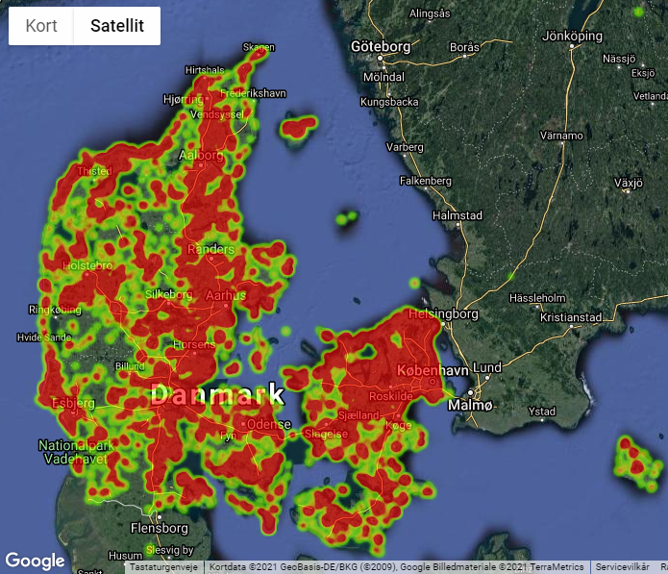
Different visualisations using Maps
Heat Maps- Visualising density or intensity of data (raster-based). Continuous spectrum
Examples: Weather, air pollution data
https://biodiversitet.nu/slutrapport
Notes:
Check extra workshops

Slide 12
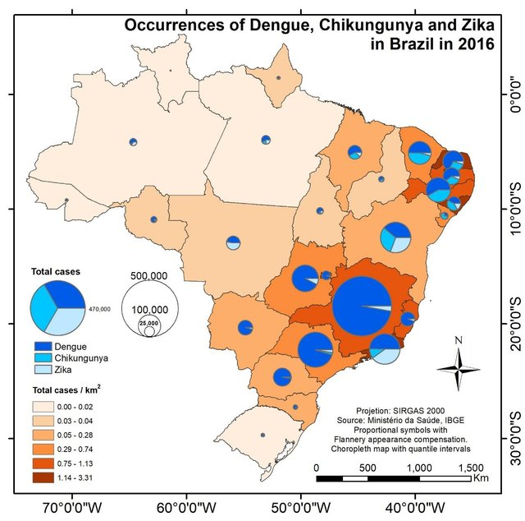
Different visualisations using Maps
Proportional Symbol Maps
Symbols with varying size to represent data
Examples: City population sizes, occurrence of disease
Vasconcelos, V. V., & Pinho, C. M. D. (2017). Multivariate Geovisualization of Dengue, Zika and Chikungunya cases in Brazil: a didactic experience. Hygeia: Revista Brasileira de Geografia Médica e da Saúde, 13(25), 91.
Notes:
Check extra workshops

Slide 13
Creating Maps in R- Basics
4 main libraries
library(ggplot2)
library(sf)
library(ggspatial)
library(rnaturalearth)
Notes:
Check extra workshops

Slide 14
Creating Maps in R- Basics
Plotting world map
library(ggplot2)
library(sf)
library(ggspatial)
library(rnaturalearth)
world <- ne_countries(scale = 'medium', returnclass = 'sf')
class(world)
Notes:
Check extra workshops

Slide 15
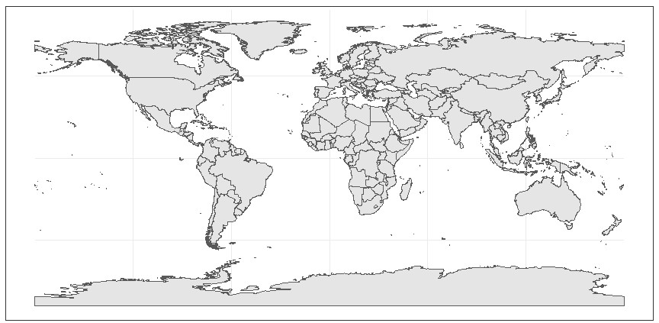

Slide 16
Creating Maps in R- Basics
library(ggplot2)
library(sf)
library(ggspatial)
library(rnaturalearth)
world <- ne_countries(scale = 'medium', returnclass = 'sf')
class(world)
map <- ggplot(data = world) + geom_sf()
map_detailed <- map +
labs(
x = ‘Latitude',
y = ‘Longitude',
title = 'World'
)
map_detailed
Notes:
Check extra workshops

Slide 17
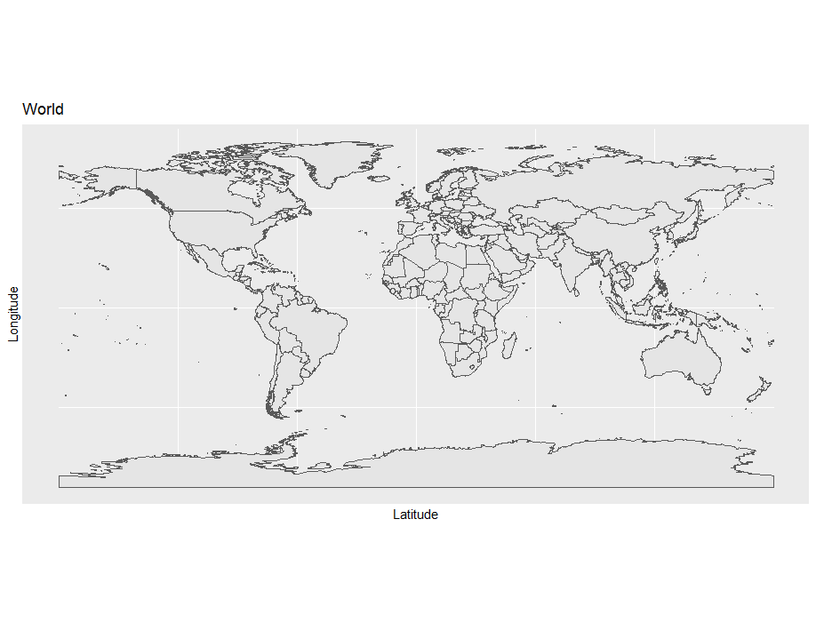

Slide 18
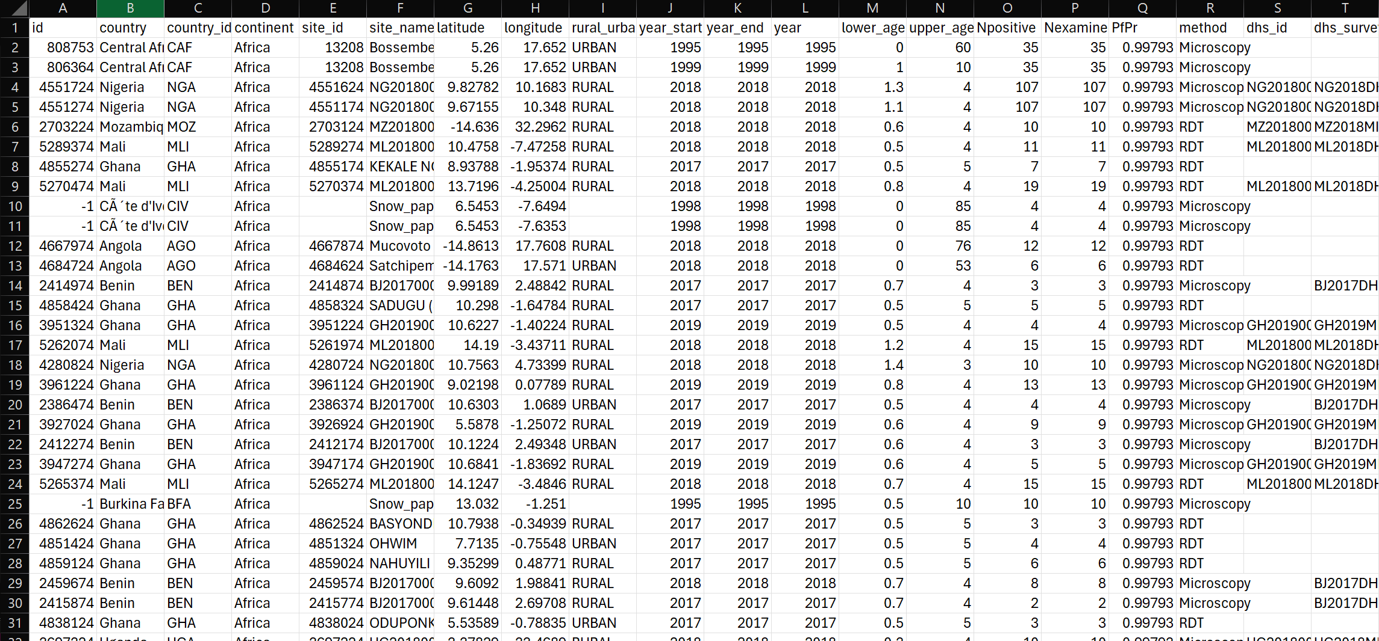
Creating Maps from your datasets
Notes:
Check extra workshops

Slide 19
Creating Maps from your datasets
data <- read.csv(‘Malaria_Dataset_DataViz.csv')
ggplot(data, aes(x=longitude, y = latitude)) +
geom_point(aes(color = PfPr))+
coord_sf() +
labs(title = 'Values', x='lon', y = 'lat') +
scale_color_continuous(name='Prevalence')
Notes:
Check extra workshops

Slide 20
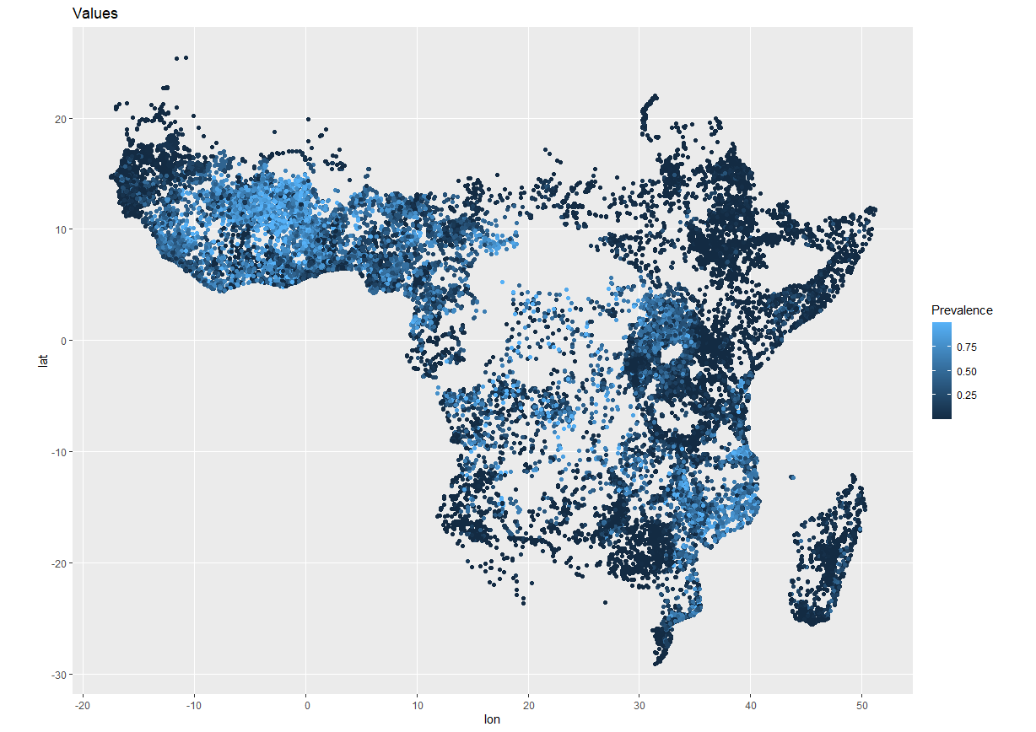

Slide 21
Introduction to Spatial Data- Tmap Library
Thematic Maps
Similar to GGPlot, but specifically targeted to maps.
Add layers just like ggplot (axes, scales, layers)
Interactive maps (day 4)
Notes:
Check extra workshops

Slide 22
Using Tmap package
library(tmap)
data('World')
tmap_mode('view')
tm_shape(World) +
tm_polygons('economy')
Example- RStudio
Notes:
Click on link!

Slide 23
Using Tmap package
library(ggplot2)
library(sf)
library(ggspatial)
library(rnaturalearth)
library(rnaturalearthdata)
#library(rnaturalearthhighres)
library(tmap)
data("World")
africa = World[World$continent == 'Africa',]
tm_shape(africa) +
tm_layout(title = 'Life Expectancy in Africa') +
tm_polygons(col = 'life_exp', palette = 'BuGn')
Notes:
Check extra workshops

Slide 24
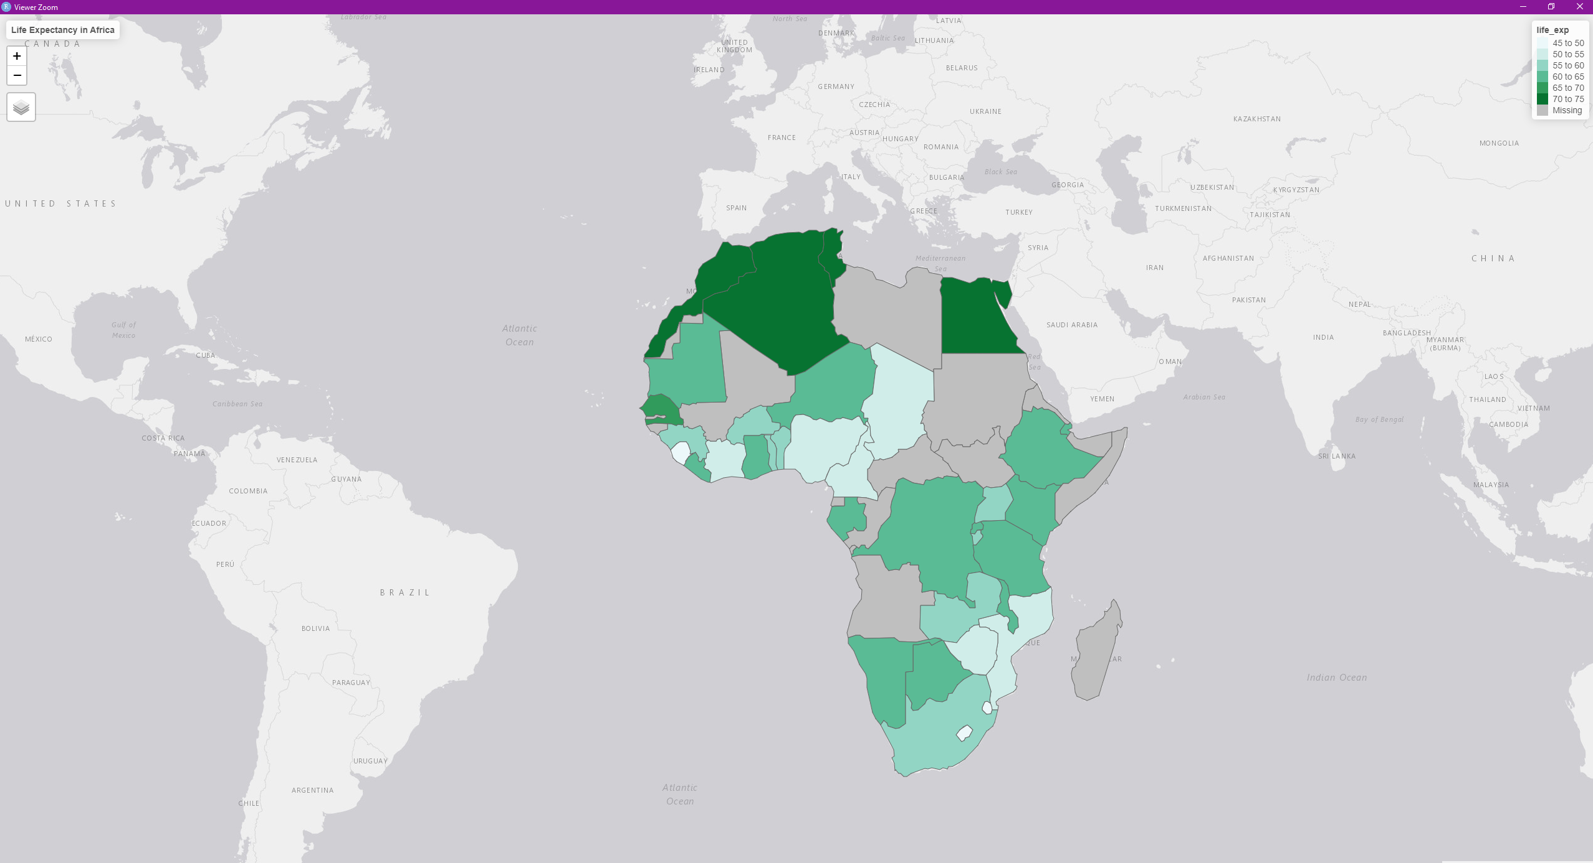

Slide 25
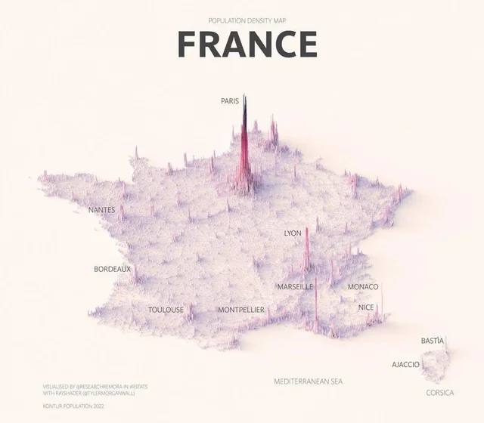
Other Visualisations
https://www.visualcapitalist.com/wp-content/uploads/2023/02/Visualizing-Population-Density-in-France-Full-Size.html
https://www.visualcapitalist.com/wp-content/uploads/2023/02/Visualizing-Population-Density-in-Italy-Full-Size.html
Notes:
Check extra workshops

Slide 26
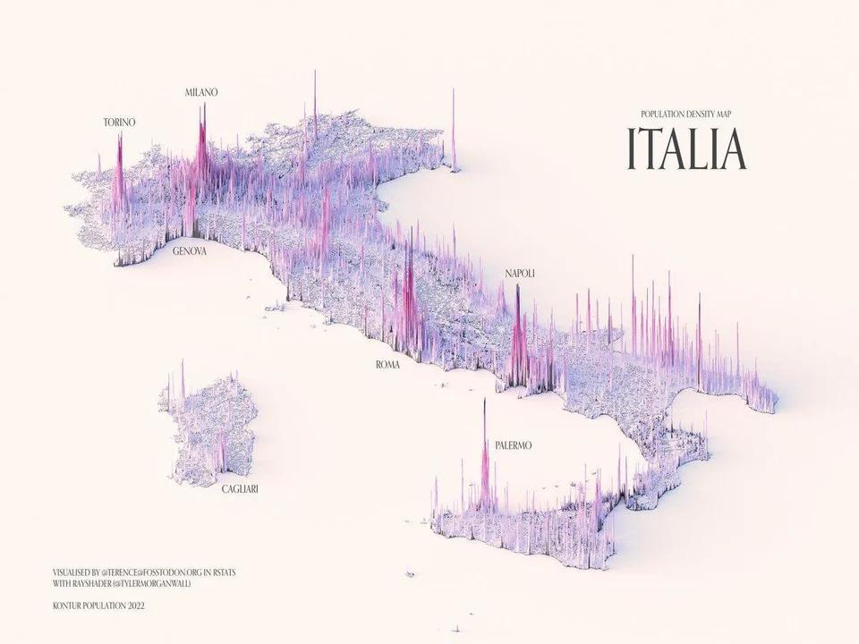
Other Visualisations
https://www.visualcapitalist.com/wp-content/uploads/2023/02/Visualizing-Population-Density-in-France-Full-Size.html
https://www.visualcapitalist.com/wp-content/uploads/2023/02/Visualizing-Population-Density-in-Italy-Full-Size.html
Notes:
Check extra workshops

Slide 27
Looks fancy…What is wrong with the map? (Day1)
https://www.visualcapitalist.com/wp-content/uploads/2023/02/Visualizing-Population-Density-in-France-Full-Size.html
https://www.visualcapitalist.com/wp-content/uploads/2023/02/Visualizing-Population-Density-in-Italy-Full-Size.html
Notes:
Check extra workshops

Slide 28
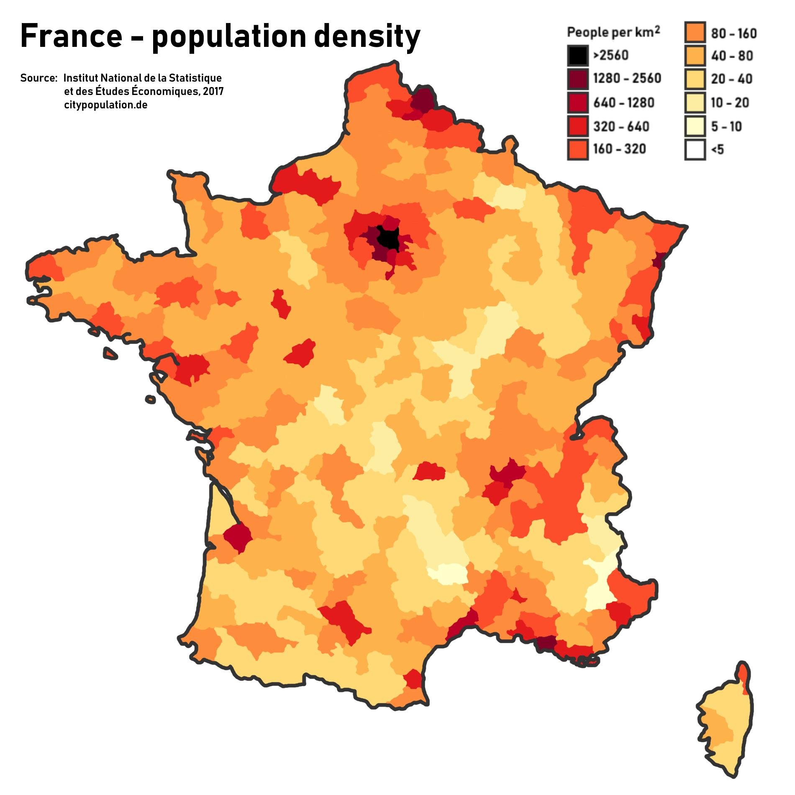
Functional vs Fancy
https://maps-france.com/maps-france-geography/france-population-map
https://www.visualcapitalist.com/wp-content/uploads/2023/02/Visualizing-Population-Density-in-France-Full-Size.html
Notes:
Check extra workshops

Slide 29
Continued in Practical Session
Installing Libraries
Basic Plots
Adding Scales, Directions, Coordinates
Adding points based on coordinates
Thematic Maps
Interactive Maps
Layers
Shading and Facets
Notes:
Check extra workshops

